Slide 1
Club Name Club #
Area | Division | District 121 | Region 13

Slide 2
Meeting#
Agenda
Club Name
Club#

Slide 3
Club Name
Opening by Sergeant At Arms
Toastmaster Name

Slide 4
Club Mission
Toastmasters International Mission
We empower individuals to become more effective communicators and leaders.
Toastmasters International Core Values
Integrity
Respect
Service
Excellence
Club Mission
We provide a supportive and positive learning experience in which members are empowered to develop communication and leadership skills, resulting in greater self-confidence and personal growth.
Club Name
Club#

Slide 5
Club Name
Presidential Address
Toastmaster Name

Slide 6
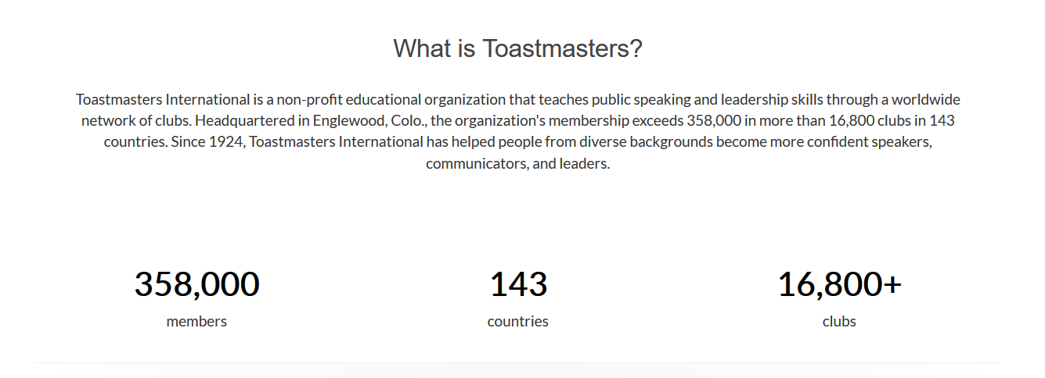
All About Toastmasters International
Club Name
Club#

Slide 7
Club Name
Opening by Toastmaster of the Day
Toastmaster Name

Slide 8
Club Name
General Evaluator Introduction of TAGL Team
Toastmaster Name

Slide 9
Club Name
Introduction of the Timer’s Role
Toastmaster Name

Slide 10
Club Name
Introduction of the Ah-Counter’s Role
Toastmaster Name

Slide 11
Club Name
Introduction of the Grammarian’s Role
Toastmaster Name

Slide 12
Word of the Day
LUCID
Club Name
Club#

Slide 13
Club Name
Introduction of the Listener’s Role
Toastmaster Name

Slide 14
Club Name
Prepared Speaker
Title:
Project:
Path :
Speech Timings :
Toastmaster Name

Slide 15
Club Name
Table Topics Session
Toastmaster Name

Slide 16
Club Name
General Evaluation Session
Toastmaster Name

Slide 17
Club Name
Speech Evaluator’s Report
Prepared Speaker :
Project:
Path :
Speech Timings :
Toastmaster Name

Slide 18
Club Name
Speech Evaluator’s Report
Prepared Speaker :
Project:
Path :
Speech Timings :
Toastmaster Name

Slide 19
Club Name
Timer’s Report
Toastmaster Name

Slide 20
Club Name
Ah-Counter’s Report
Toastmaster Name

Slide 21
Club Name
Grammarian’s Report
Toastmaster Name

Slide 22
Club Name
Listener’s Report
Toastmaster Name

Slide 23
Club Name
General Evaluator’s Complete Report
Toastmaster Name

Slide 24
Zoom Polls
Club Name
Club#

Slide 25
Club Name
Closing Remarks by Toastmaster of the Day
Toastmaster Name

Slide 26
Club Name
Recognitions & Closing by President
Toastmaster Name

