Slide 1
MOMENTS OF TRUTH Club Officers’ Training Program District 121 | Region 13

Slide 2
What is Moments of Truth?
A self analysis of the clubs’ affairs.
A special reflective meeting for members
to assess the state of the club.
agree on actions for continuous improvement.
implement the action plan.
monitor the implementation.

Slide 3
Why Moments of Truth?
Objective: identify challenges and find solution.
Understand the reality (Present Situation Analysis).
Identify root cause of problems, if any.
Decide on Best Practices to solve the problem.
Formulate an Action Plan.
Follow up on Action Plan and track implementation.

Slide 4
6 MOMENTS OF TRUTH
First Impressions – First impressions of a guest visiting club.
Membership Orientation – How does your new member feel.
Fellowship, Variety and Communication – General club environment-Involvement out side club.
Program Planning and Meeting Organization – Planning of meetings.
Membership Strength – Retention of members/ Increasing members.
Achievement Recognition – Members attracted to the club.

Slide 5
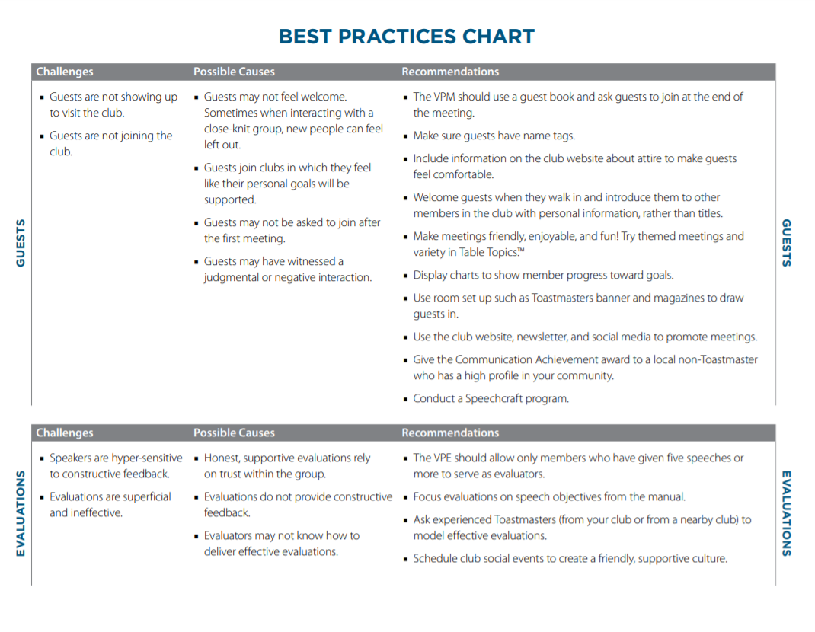
Important Documents
To be submitted to District 121 with consolidated data of Club’s Moments of Truth session.
Contains the following sheets:
Club Details
MoT Handout (editable)
Challenges
Action Items
Best Practices
MOMENTS OF TRUTH MANUAL
BEST PRACTICES CHART
MOMENTS OF TRUTH HANDOUT
CLUB QUALITY STANDARDS EVALUATION
MOMENTS OF TRUTH SLIDES
D121 MOT WORKSHEET
Notes:
https://toastmasterscdn.azureedge.net/medias/files/department-documents/club-documents/290-moments-of-truth/en/290a-moments-of-truth.pdf

Slide 6
ALL DOCUMENTS IN ONE PLACE d121toastmasters.org

Slide 7
SUGGESTED PROCESS Moments of Truth Process for Clubs
Announce Early
at least 2 weeks in advance
availability of all members
availability of Area Director.
Six Teams (or lesser, based on the membership strength)
Each Team is assigned one/two MoT.
One Team Leader
MoT Facilitator (any member) - explains the process to meeting

Slide 8
SUGGESTED PROCESS Moments of Truth Process for Clubs
Each Team rates every standard on scale of 1 – 5.
For each item that is rated 3 or lower.
look at the Best Practices Chart and discuss
What is the cause of this challenge?
What can we do to fix it?
Assigned Person of Each team presents challenges / recommendations
Challenges, Action Items and Best Practices recorded in the MoT Worksheet.
We meet the standard
Never
Rarely
Sometimes
Often
Always

Slide 9
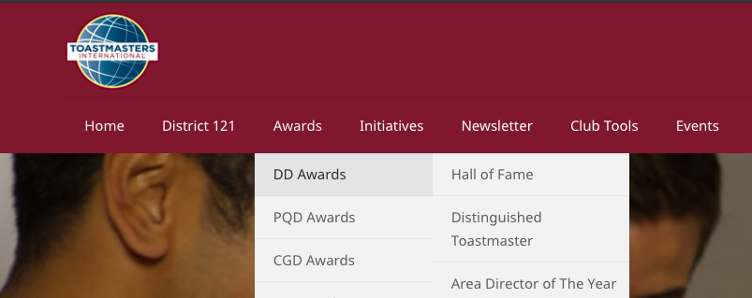
After the MoT Session
Area Director to guide formulating the Action Plan.
Club President to submit the MoT Worksheet to the Office of the Administration Manager, District 121, via District 121 website.
Area Director to closely monitor the progress made by the club towards implementation of the Action Plan (criterion for ‘Metamorphosis Award’).

Slide 10
Deadline for submission of MoT Worksheet to District 121
30th November 2021
Please Note:
Submission of MoT Worksheet before the deadline is a mandatory requirement for Metamorphosis Award.
Club will be awarded 1 point for Hall of Fame Award (Criteria: Administration) upon successful submission of MoT Worksheet before the deadline.

Slide 11
For any queries, contact:
Office of the Administration Manager
District 121, Toastmasters International
d121.amoffice@gmail.com
www.d121toastmasters.org

