Slide 1
DISTINGUISHED CLUB PROGRAM & CLUB SUCCESS PLAN
DISTRICT 121

Slide 2
1.
DISTINGUISHED CLUB PROGRAM

Slide 3
WHAT IS THE DISTINGUISHED CLUB PROGRAM?
The Distinguished Club Program (DCP) includes 10 goals that your club should
strive to achieve each year. They are divided into:
Education
Membership
Training
Administration

Slide 4
DISTINGUISHED CLUB PROGRAM – WHY?
Planning Mode & Getting Organized
Quality
Enhance Membership Experience
Celebration & Recognition

Slide 5
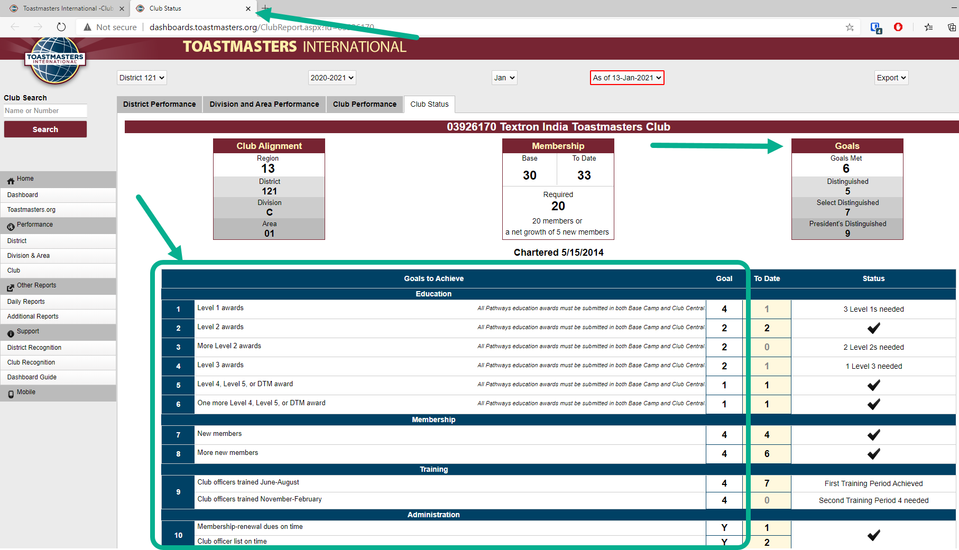
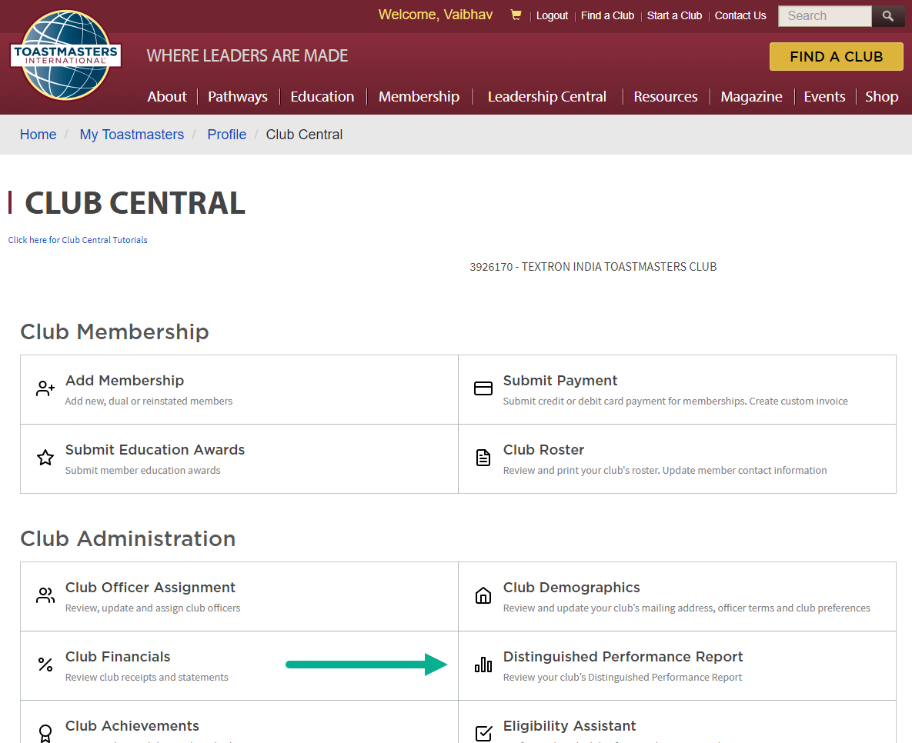
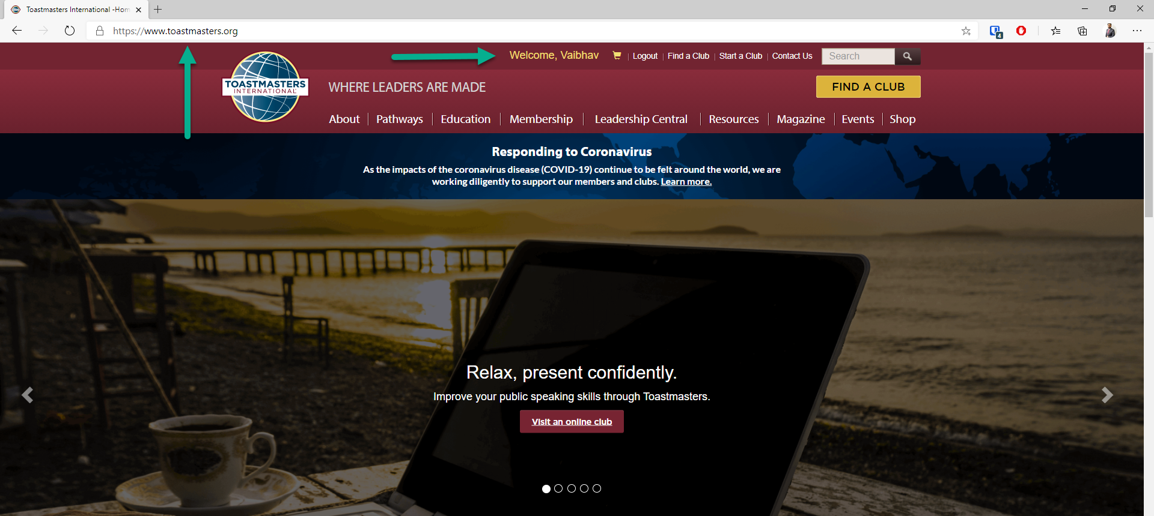
HOW TO NAVIGATE TO DCP REPORT?

Slide 6
DCP AT A GLANCE
Clubs must have either 20 members or a net growth of at least five new members as of June 30
Credit may be received for only one type of education award per member, per year, per club.
A maximum of six will count toward DCP credit
Distinguished
(5 DCP points)
Select Distinguished
(7 DCP points)
President’s Distinguished
(9 DCP points)
EDUCATION
TRAINING
1. Four Level 1 awards achieved
2. Two Level 2 awards achieved
3. Two more Level 2 awards achieved
4. Two Level 3 awards achieved
5. One Level 4, Level 5, or DTM award achieved
6. One more Level 4, Level 5, or DTM award achieved
9. A minimum of four club officer roles trained during
each of the two training periods
ADMINISTRATION
10. On-time payment of membership dues accompanied by the names of eight members (at least three of whom must be renewing members) for one period and on-time submission of one club officer list
MEMBERSHIP
7. Four new, dual, or reinstating members
8. Four more new, dual, or reinstating members

Slide 7
EDUCATION
- BUT HOW DO WE ACHIEVE IT?
Four Level 1 Awards Achieved
Two Level 2 Awards Achieved
Two More Level 2 Awards Achieved
Two Level 3 Awards Achieved
One Level 4, Level 5, or DTM Awards Achieved
One Level 4, Level 5, or DTM Awards Achieved
Deadline to submit Education Awards: June 30, 2021
May 5, 2021

Slide 8
MEMBERSHIP
- BUT HOW DO WE ACHIEVE IT?
Four New, Dual, or Reinstating Members
Four More New, Dual, or Reinstating Members
Membership Building Program Windows:
Smedley Award - August 1 – September 30 2020
Talk Up Toastmasters - February 1 – March 31 2021
Beat the Clock - May 1 – June 30 2021
May 5, 2021

Slide 9
TRAINING
A minimum of four club officer roles trained during each of the two training periods
Super 7 Award - District 121
Awarded to Clubs that have all 7 club officers trained in both
terms TLI (District organized Club Officers Training Program)
Club should be of good standing as of Division Meet
Awarded at : Respective Division Meets
Deadline to submit Super 7 Awards: 2nd TLI

Slide 10
ADMINISTRATION
On-time payment of membership dues accompanied by
the names of eight members (at least three of whom must
be renewing members) for one period
On-time submission of one club officer list.

Slide 11
2.
CLUB SUCCESS PLAN

Slide 12
WHAT IS THE CLUB SUCCESS PLAN?
The Club Success Plan (CSP) is a tool that enables clubs to plan and achieve the
Club goals described in the Distinguished Club Program (DCP).
It is recommended that the club have an Executive Committee meeting discussion before
submitting the Club Success Plan to their respective Area Directors.
Deadline to submit revised CSP to AD: 31st Jan 2021

Slide 13
CLUB SUCCESS PLAN – IN DEPTH
Team Compilation
Core Values and Team Operating Principles
Meeting Protocols
Team Interaction
Behavioral Norms
Potential Obstacles
Situational Analysis
Goals to Achieve
Action Plan
Vision: Attainable + Inspiring = Motivated Members

Slide 14
WIIFME?
A HEALTHY CLUB MEANS HEALTHY MEMBERS!!
THIS MEANS YOU!

Slide 15
SUMMARY
Achieve educational goals/awards
Get new members on board
Ensure club officers are trained
Ensure to pay dues & submit the officer list on time

Slide 16
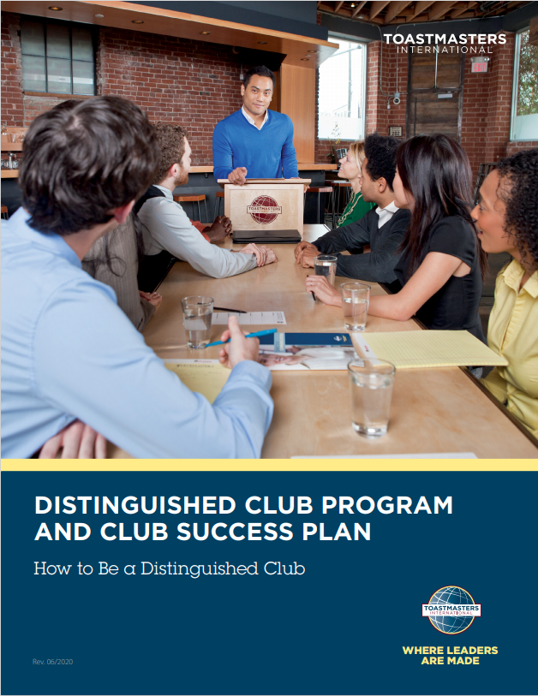
DISTINGUISHED CLUB PROGRAM AND CLUB SUCCESS PLAN
(ITEM 1111)
Free PDF Download

Slide 17
THANK YOU!
For any questions on the Distinguished Program, write to d121.pqdo@gmail.com

